Slide 1
Data pre-processing

Slide 2
Handling Missing Values

Slide 3
Categorical Variables
Label Encoding
One Hot Encoding

Slide 4
Label Encoding

Slide 5
Before Label Encoding
Hello
Country
France
Germany
Spain
France
Spain
Country Dictionary
France | 1
Germany | 2
Spain | 3
After Label Encoding
Hello
Country
1
2
3
1
3

Slide 6
One Hot Encoding

Slide 7
Before One-Hot Encoding
Hello
Country
France
Germany
Spain
France
Spain
After One-Hot Encoding
Hello
France | Germany | Spain
1 | 0 | 0
0 | 1 | 0
0 | 0 | 1
1 | 0 | 0
0 | 0 | 1

Slide 8
Feature Scaling
Standardization
Normalisation

Slide 10
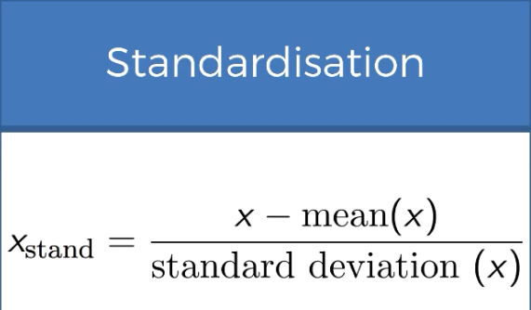
Standardisation

Slide 11
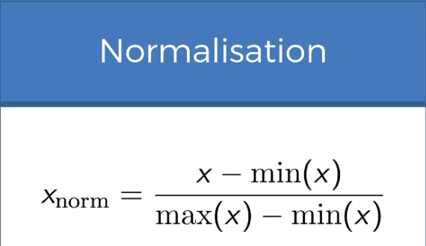
Normalisation
Normalized Values lie in the range of 0 to 1.

